Slide 1

Notes:
Introductions
Experience

Slide 2


Slide 3

The Beginnings
When: March 2015
When: October 2021
Who: Doug Bodily
Owen Hammond
Nate Hosac
Matt Smith
Who: Doug Bodily
Owen Hammond
Nate Hosac
Matt Smith
Tim Nelson

Slide 4
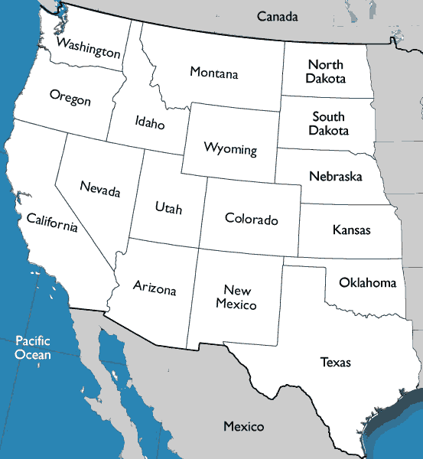

OUR GROWING FOOTPRINT
7
Skilled Nursing
Senior Living ALF/ILF
Home Health and Hospice
2
32
20
1
2
1
2
1
1
1

Slide 5
THE VISION
What?
Why?
How?
We are a skilled nursing, senior living, home health and hospice family of companies dedicated to quality outcomes and employee development through a culture of caring at every level of patient and employee interaction.
We endeavor to create a culture of operational excellence, ownership, and empowerment through an informed decision making process as partners in a flat organizational structure.
We Care about people! We strive to be a ”Force for Good for our employees, our patients and the healthcare industry.

Slide 6
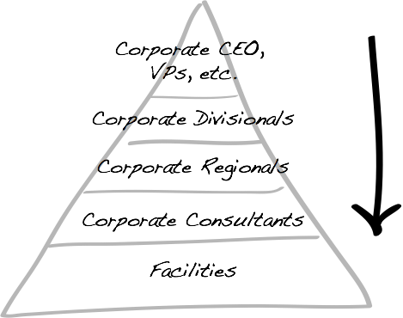
Notes:
Many different ways to structure a company many historically look like this.
We don't we are a flat line organization
We are all partners with different sets of skills
We learn and grow from all of our partners in contrast to one regional president
We encourage one another to be vulnerable and to also speak up

Slide 7

Teams
Notes:
Each facility is in a Team of 3 or 4 other facilities to partner with the expectation that they collaborate often and hold each other accountable
The Home office is a service center designed to serve, support and inspire the field.

Slide 8


Slide 9

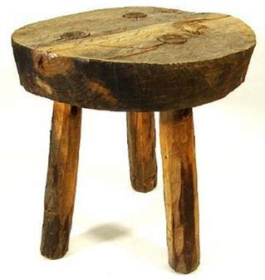
3 Pillars
Clinical – Cultural - Financial

Slide 10

THANK Y U!

